Slide 1
Background 第一段
性能方面
ConvNeXt重新超越了transformer
现象
Transformer系列在CV领域性能呈现出超越CNN的趋势
讨论
Transformer系列在CV领域是否将会取代CNN呢？
回答
应当考虑：
性能方面
效率方面
效率方面
CNN相比transformer的后续加速更友好

Slide 2
Motivation 第二段
ConvNeXt Block 2022
①
借鉴ViTs，采用大感受野，但CNN无法实现像ViTs那样的动态感受野，单纯的大感受野由于提取纹理偏置的能力较弱，难以适应细粒度任务或低分辨率任务
② & ③
用Dense来实现PWConv，依赖反复的形状变换等操作，效率低且不支持后续优化需要的算子融合、剪枝等操作
dim
①
DwConv 7×7 dim;
LayerNorm
②
PWConv(Dense) 4×dim;
GELU
④
捷径分支尤其占用内存，对效率有很大影响，[文献]实现了ResNet捷径分支的消除，但依赖了ReLU激活的非负性不够灵活
③
PWConv(Dense) dim
④

Slide 3
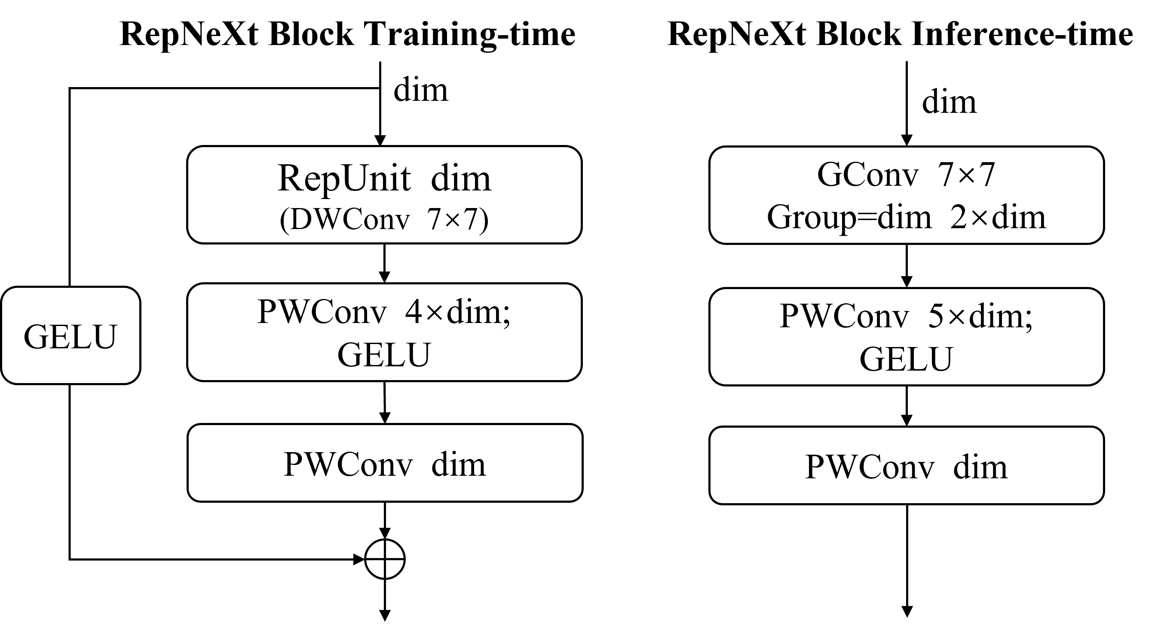
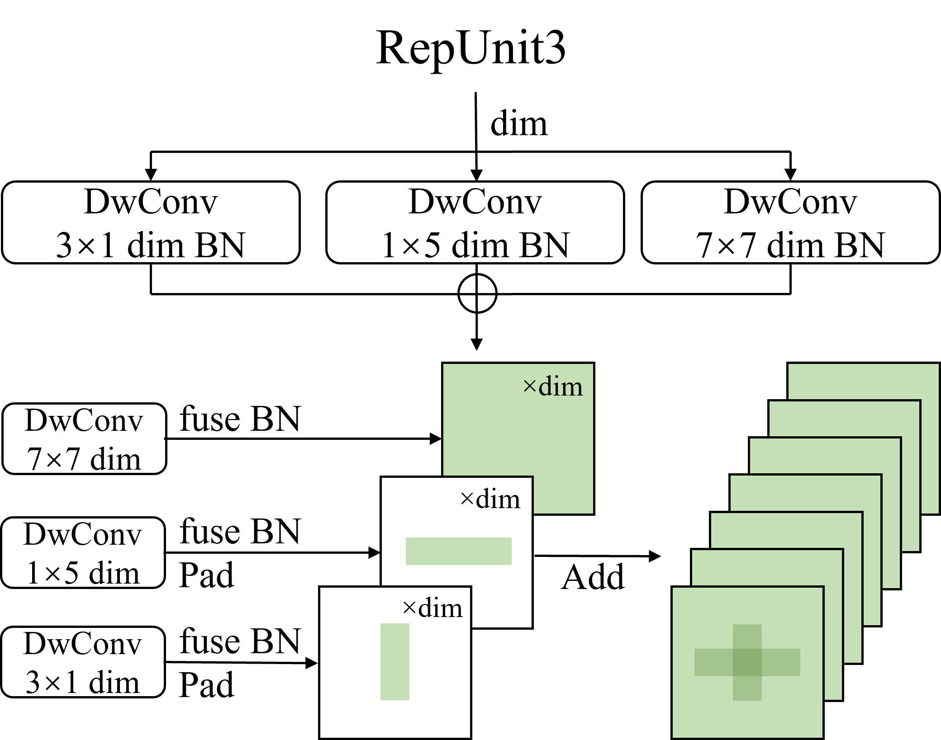
Contribution 第三、四段
①
④
② & ③
①
使用一个可重参数化的结构RepUnit来替代7×7大小的DWConv，RepUnit采用并联多尺度卷积来实现，更贴合动态感受野的思想，能适应低分或细粒度任务
② & ③
用卷积来实现PWConv，能够支持后续优化需要的算子融合、剪枝等操作，达到高效性
Contribution总结：第四段
We proposed a reparameterizable convolutional neural network named RepNeXt, which is a remarkable attempt to implement a CNN with both high performance and high efficiency.
The reparameterization structure we designed is simple and easy to implement, which does not increase the cost of training, and can perform well in low-resolution tasks and fine-grained tasks.
We implement shortcut reparameterization in the presence of DWConv in the main branch and extend the generality of the shortcut branch reparameterization by adding an activation layer to the shortcut branch. This approach breaks the high performance CNN design paradigm, but offers valuable "access friendliness" and "pruning friendliness" with very little loss of accuracy.
我们进一步结构化剪枝，获得了更块的速度(剪了再说吧)。
④
捷径分支添加激活层，大大增加捷径分支消除的灵活性，相比部分激活更加简洁易懂且高效率

Slide 4
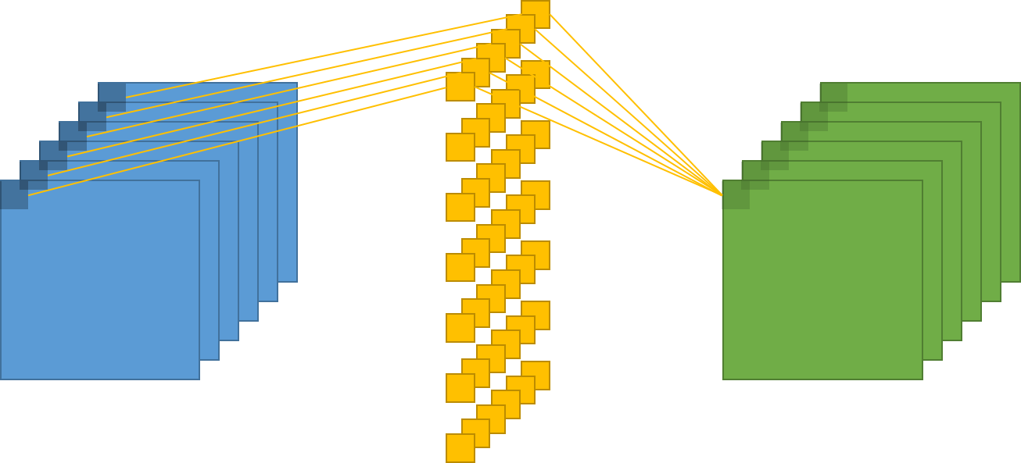
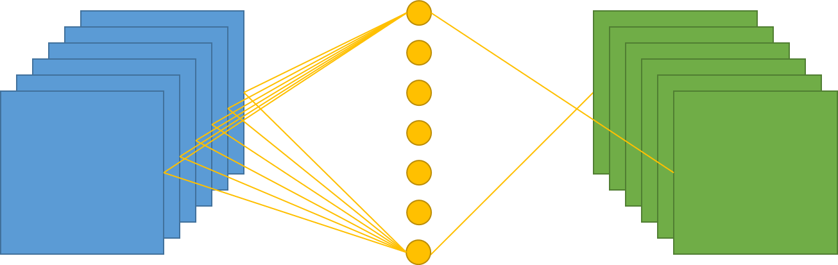
$$O_{dhw}=\sum_{c=1}^{C}{F_{dc00}×I_{chw}}+{Bias}_{d}$$
$$F_{DC11}$$
$$I_{CHW}$$
$$O_{DHW}$$
$$W_{DC}=squezze(F_{DC11})$$
$$I_{HWC}=transform(I_{CHW})$$
$$O_{hwd}=\sum_{c=1}^{C}{I_{hwc}×W_{cd}}+{Bias}_{d}$$
$$W_{DC}$$
$$I_{CHW}$$
$$O_{DHW}$$
$$O_{DHW}=transform(O_{HWD})$$

Slide 5
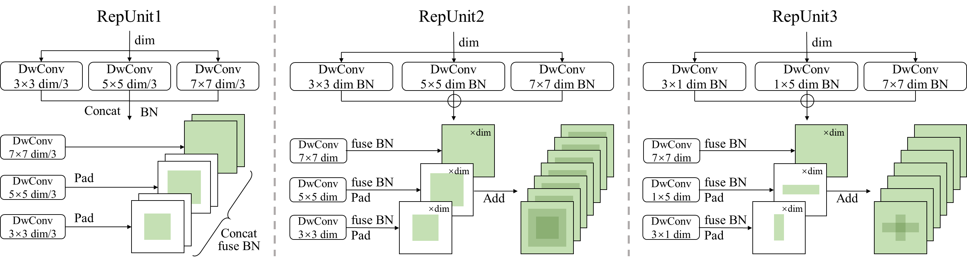
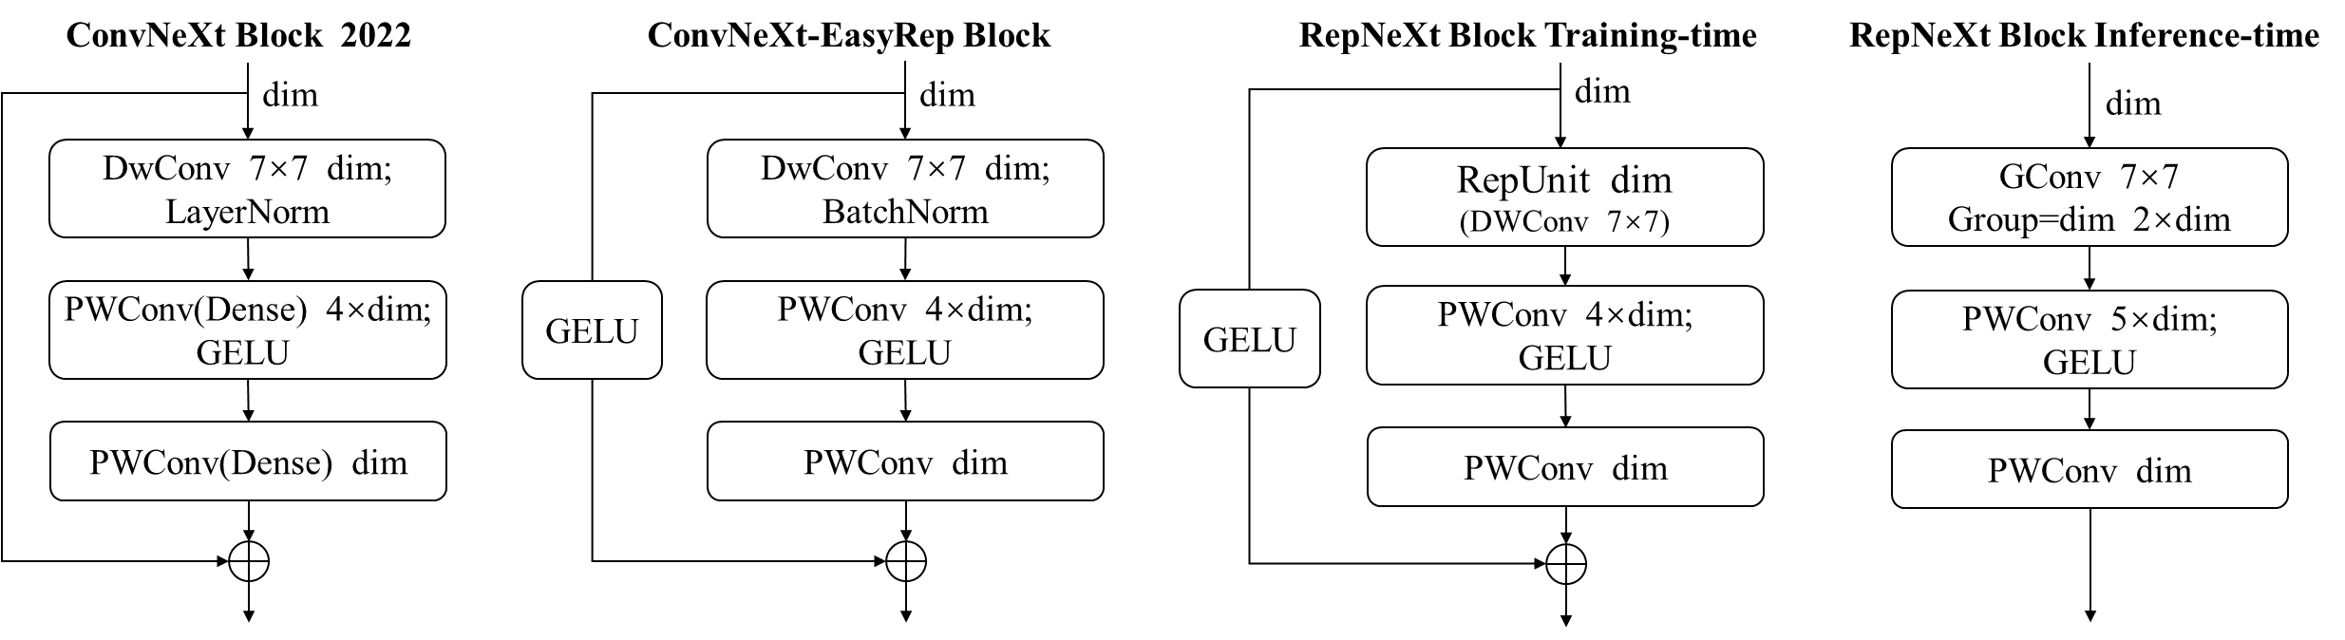
3.1 Block Design for Feature Extraction
目的：为了细粒度、低分辨率任务的适应性，需要大小感受野同时存在，更加贴合ViTs可变感受野的理念。
做法：使用不同尺度的卷积核并联(并联→拼接 & 并联→相加)
网络参数更少了，加快训练
已经能在细粒度&低分上性能好
ImgNet性能下降很多
细粒度&低分上性能好
巨大的网络宽度和参数量，难以训练，性能也不够好
保持大宽度不变，压缩参数量，提升性能
细粒度&低分上性能好
展示完整的Block
总结

Slide 6
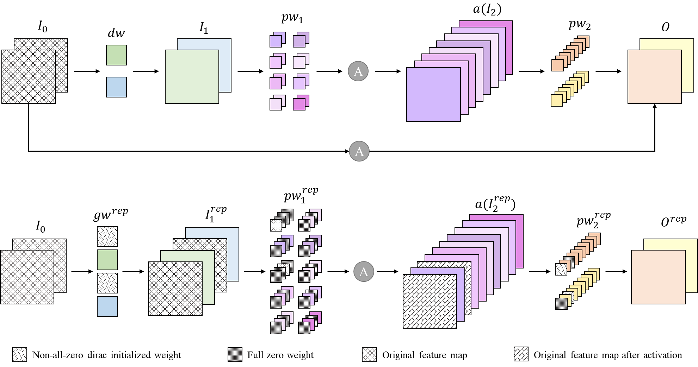
3.2 Shortcut Reparameterization
目的：解决多分支存在时由于访存压力带来的推理低效率
做法：捷径分支重参数化

Slide 7
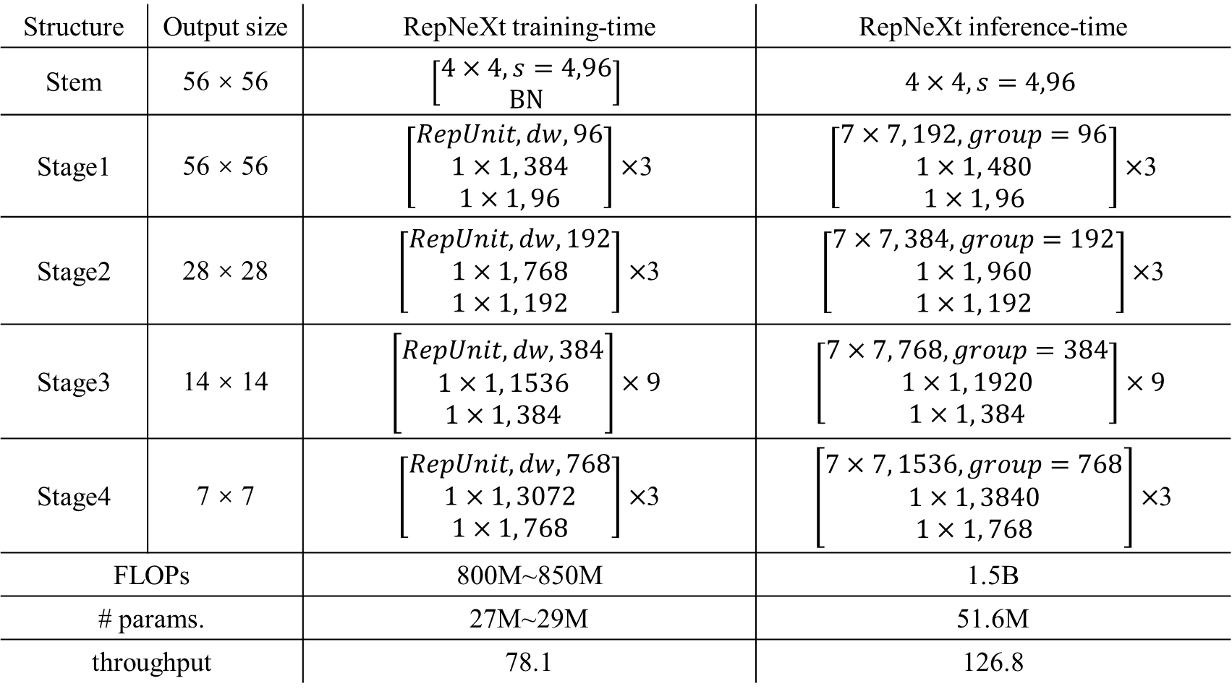
3.3 网络架构说明
Structure | Output size | RepNeXt training-time | RepNeXt inference-time
Stem | 56 × 56 | $$\left[\begin{aligned}4×4, s=4,96 \\ BN\end{aligned}\right]$$ | $$4×4, s=4,96$$
Stage1 | 56 × 56 | $\left[\begin{aligned}RepUnit,dw, 96 \\ 1×1, 384 \\ 1×1, 96\end{aligned}\right]×$3 | $\left[\begin{aligned}7×7, 192,group=96 \\ 1×1, 480 \\ 1×1, 96\end{aligned}\right]×$3
Stage2 | 28 × 28 | $\left[\begin{aligned}RepUnit,dw, 192 \\ 1×1, 768 \\ 1×1, 192\end{aligned}\right]×$3 | $\left[\begin{aligned}7×7, 384,group=192 \\ 1×1, 960 \\ 1×1, 192\end{aligned}\right]×$3
Stage3 | 14 × 14 | $$\left[\begin{aligned}RepUnit,dw, 384 \\ 1×1, 1536 \\ 1×1, 384\end{aligned}\right]×9$$ | $$\left[\begin{aligned}7×7, 768,group=384 \\ 1×1, 1920 \\ 1×1, 384\end{aligned}\right]×9$$
Stage4 | 7 × 7 | $\left[\begin{aligned}RepUnit,dw, 768 \\ 1×1, 3072 \\ 1×1, 768\end{aligned}\right]×$3 | $\left[\begin{aligned}7×7, 1536,group=768 \\ 1×1, 3840 \\ 1×1, 768\end{aligned}\right]×$3
FLOPs |  | 800M~850M | 1.5B
# params. |  | 27M~29M | 51.6M
throughput |  | 78.1 | 126.8

Slide 8
4.1 Experienments on ImageNet Classification
4.2 Experiments on Fine-grained and Low Resolution Image Classification
4.3 Experiments on Downstream Tasks
4.3 further accelerated experiments

